Slide 1







Top layer/text
Dec 01, 2023
Episode Details
Zitiception?
Working with xweb
Hosting the ZAC
tv ‘noise’

Slide 2

Top layer/text
Nov 17, 2023
Episode Details
HA IS HERE! It’ll be a full house this week! We’ll be looking at and discussing what HA is, how it works, try it out and see where it goes. Bring your HA questions to the livestream!
tv ‘noise’

Slide 3

Top layer/text
Nov 10, 2023
Episode Details
Working Session! Exploring the Java and Golang SDKs by trying to access a Postgres db + ask any burning OpenZIti questions you want answered!
tv ‘noise’

Slide 4




Top layer/text
Nov 03, 2023
Episode Details
zrok for servers?
tv ‘noise’

Slide 5
Top layer/text
Oct 27, 2023
Episode Details
User Spotlight! DeltaSecure & hypervisors!
tv ‘noise’

Slide 6
Top layer/text
Nov 10, 2023
Episode Details
Working Session! Exploring the Java and Golang SDKs by trying to access a Postgres db + ask any burning OpenZIti questions you want answered!
tv ‘noise’

Slide 7
Top layer/text
Oct 06, 2023
Episode Details
Let’s look at the zrok SDK!!
tv ‘noise’

Slide 8


Top layer/text
Sep 29, 2023
Episode Details
Working Session and Office Hours!
tv ‘noise’

Slide 9
May 26, 2023
Episode Details
Office Hours and livestream

Slide 10

Top layer/text
Sep 22, 2023
Episode Details
User Spotlight! Cloud Underground
tv ‘noise’

Slide 11

Top layer/text
Sep 15, 2023
Episode Details
User Spotlight! ztsolutions.io
tv ‘noise’

Slide 12
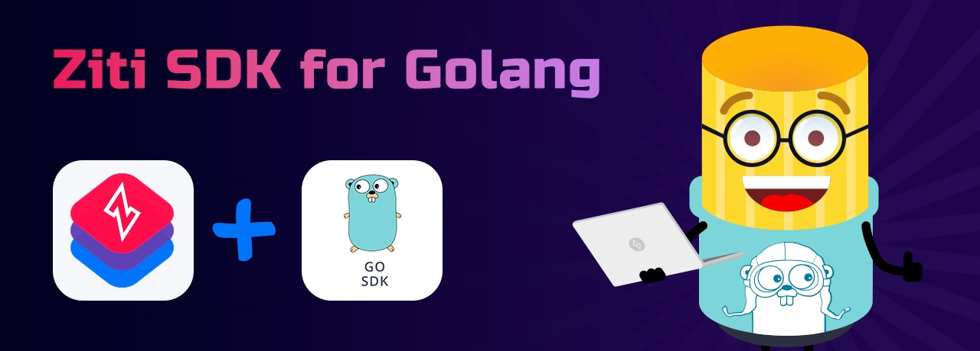
Sep 08, 2023
Episode Details
Automating OpenZiti and using the Golang SDK

Slide 13
Top layer/text
Sep 01, 2023
Episode Details
Link Groups!
tv ‘noise’

Slide 14

Top layer/text
Aug 25, 2023
Episode Details
User Spotlight! NetFoundry?!?!
tv ‘noise’

Slide 15
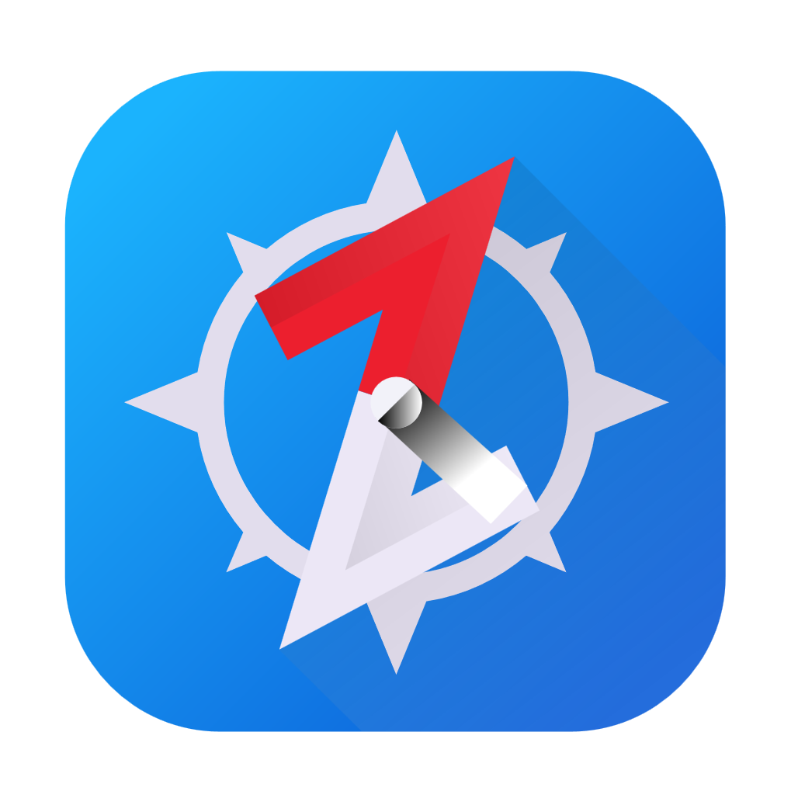
Aug 18, 2023
Episode Details
Let’s self-host BrowZer! (again)

Slide 16
Aug 4, 2023
Episode Details
zrok public beta!!!

Slide 17


Jul 21, 2023
Episode Details
Study Time
OpenZiti Overview!

Slide 18
What is Zero Trust
WHY Zero Trust
Anatomy of the overlay
Controller
Router
Tunnelers/clients/SDK
What’s a/an:
Service
Config
Service Policy
Identity
Study Time

Slide 19

Jul 14, 2023
Episode Details
User Spotlight! Analytics HQ!

Slide 20
Jun 23, 2023
Episode Details
Let’s self-host BrowZer!

Slide 21

Jun 23, 2023
Episode Details
User Spotlight! Paul Otto - RAFT

Slide 22
Jun 09, 2023
Episode Details
Just how DOES BrowZer work???

Slide 23
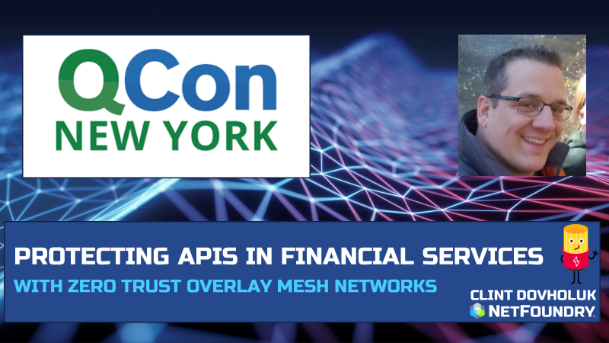
Jun 02, 2023
Episode Details
Securing APIs with OpenZiti and SPIRE! Application Embedded Zero Trust!

Slide 24
May 26, 2023
Episode Details
Office Hours and livestream

Slide 25


ZSSH with oidc!

Slide 26

Edgex Foundry + OpenZiti

Slide 27
Apr 28, 2023
Episode Details
Adding OpenZiti to microservice sample code

Slide 28


Apr 14, 2023
Episode Details
Even more zrok!!!
zrok in docker?
zrok in Kubernetes!?

Slide 29
Mar 31, 2023
Episode Details
OIDC, Keycloak, IdP, ext-jwt-signers

Slide 30
Mar 17, 2023
Episode Details
Working session: OpenZiti Network in Kubernetes!

Slide 31
Mar 10, 2023
Episode Details
Qcon 2023 Presentation

Slide 32

Mar 03, 2023
Episode Details
Monthly Forum

Slide 33
Feb 17, 2023
Episode Details
Release note read out
zrok in docker
zrok in Kubernetes!?

Slide 39
Feb 17, 2023
Episode Details
Release note read out
zrok in docker
zrok in Kubernetes!?

Slide 40
Feb 10, 2023
Episode Details
User Spotlight!

Slide 41
Feb 3, 2023
Episode Details
New container images!?

Slide 42
Jan 18, 2023
Episode Details
Javier Diaz from Jeju National University. Blockchain, OpenZiti and Intent-based networking

Slide 43
Dec 9, 2022
Episode Details
Release Notes:
0.21.11
Zitification – Beats!
SERPs

Slide 44
Jan 12, 2023
Episode Details
Monthly Ideas Forum

Slide 45
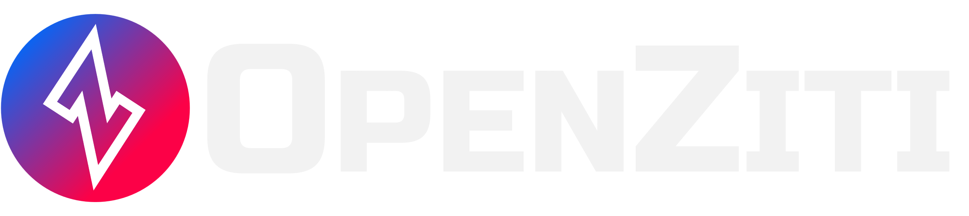

Nov 18, 2022
Episode Details
Release Notes:
0.26.11+
+

Slide 46
Nov 11, 2022
Episode Details
Release Notes:
0.26.11+
Looking at samples

Slide 47
Nov 04, 2022
Episode Details
Release Notes:
0.26.10+
BrowZer!!!

Slide 48
Oct 28, 2022
Episode Details
Release Notes:
0.26.10+
Working Session!

Slide 49
Oct 21, 2022
Episode Details
Release Notes:
0.26.10+
Config types – take 2!

Slide 50
Oct 07, 2022
Episode Details
Release Notes:
0.26.9+
Config types!

Slide 51
Sep 23, 2022
Episode Details
Release Notes:
0.26.8+
Linux UI/Packaging
Python SDK
Hacker News postings
other?

Slide 52
Sep 16, 2022
Release Notes:
0.26.5+
Multi-Region APIs with Kubernetes
Episode Details

Slide 53
Sep 09, 2022
Release Notes:
0.26.4+
VPN vs Zero Trust
User Experience
Episode Details

Slide 54
Sep 02, 2022
Release Notes:
0.26.4+
New ZDEW UI?
Episode Details

Slide 55
Aug 26, 2022
Release Notes:
0.26.4+
Custom PKI with OpenSSL?
Episode Details

Slide 56
Aug 12, 2022
Release Notes:
0.26.4+
CVE’s, Lambdas and OpenZiggy
Episode Details

Slide 57
Aug 05, 2022
Release Notes:
0.26.4+
ziti CLI and debugging
Episode Details

Slide 58
July 22, 2022
Release Notes:
0.26.2+
Application Embedded LDAP Client
Episode Details

Slide 59
July 15, 2022
Release Notes:
0.26.1+
Posture Checks
Episode Details

Slide 60
July 08, 2022
Release Notes:
0.26.1+
What is ‘zitify’?
Episode Details

Slide 61
July 01, 2022
Release Notes:
0.26.0+
Making ZAC and the Management API DARK!
Episode Details

Slide 62
June 17, 2022
Release Notes:
0.25.12+
Zitifying Ansible!?!?!
Episode Details

Slide 63
June 10, 2022
Release Notes:
0.25.11+
Python support and other SDK conversation
Episode Details

Slide 64
June 3, 2022
Release Notes:
None
Replacing SSH bastions with OpenZiti
Episode Details

Slide 65

June 3, 2022
Release Notes:
None
Replacing SSH bastions with OpenZiti
Episode Details

